Slide 1

ADVANCED DATA MINING AND PREDICTIVE ANALYTICS GROUP PROJECT LOAN DEFAULT AND LOSS INCURRED PREDICTION USIND DATA MINING AND MACHINE LEARNING TECHNIQUES GROUP 11
Ritika Kalyani
Akhil Seliveri
Rajesh Katherasala
Vamshi Krishna Navath

Slide 2

1.PROJECT GOAL:
The project aims to use machine learning to enhance financial risk assessment by predicting both the probability of loan defaults and the potential financial losses associated with them. Unlike traditional models that only classify loans as "good" or "bad," this approach provides a more comprehensive analysis. It supports financial institutions in optimizing loan portfolios, allocating resources, and meeting regulatory requirements for capital reserves by accurately estimating both default likelihood and loss severity.
This advanced, data-driven model bridges traditional banking and asset management perspectives, enabling improved decision-making and financial stability. By integrating these views, the project fosters innovation and highlights how machine learning can revolutionize credit risk management, benefiting both lenders and the broader financial ecosystem.

Slide 3

2. OVERVIEW OF DATA, INCLUDING DATA EXPLORATION ANALYSIS:
Data Exploration:
We loaded all of the necessary libraries for data exploration, data visualization, and model construction in the first stage. The data was loaded from our local computer using the "read.csv" function in the following step. After that, we began analyzing the data to gain a deeper understanding of its statistics and structure. Three main files—train_v3.csv, test_v3.csv, and test__no_lossv3.csv—make up the dataset supplied for the project. These files include a variety of attributes related to loan defaults and the losses that accompany them. The target variable, the "loss" caused when a loan fails, is one of 763 variables and 80,000 observations that constitute the training data. 25,471 observations compose the test data, which has the same structure as the training data. After the model has been trained, the third dataset, test__no_lossv3.csv, can be used to generate predictions because it is comparable to the test data but does not contain the "loss" variable.
Using the str() method, we can look into the training data's structure and find a variety of numerical and categorical variables, such as IDs and features like f1, f3, f4, and others. The model's target variable, the "loss" variable, has a range of 0 to 100, with many values centered around 0, suggesting that there are many loans with no loss. A review of the first few columns shows that a number of features (such as f1 with 132 missing values and f5 with up to 1177 missing values) have missing data. This means that throughout the preprocessing stage, missing data must be handled appropriately.

Slide 4
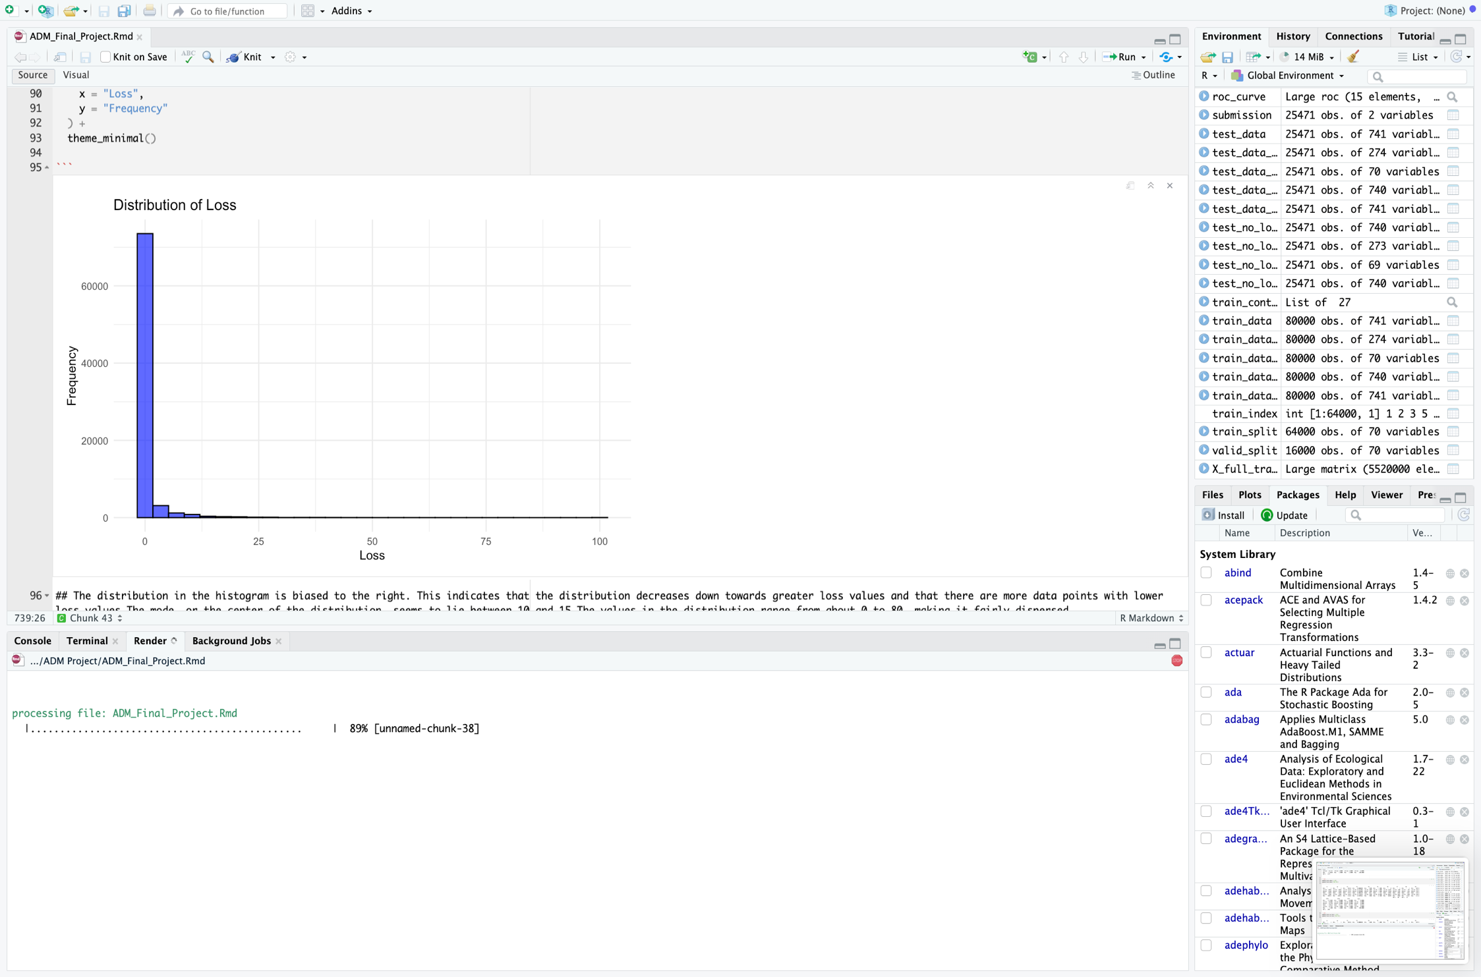
Data Visualization:
To analyze the distribution and characteristics of the "loss" variable, a histogram was created. This visualization provided insights into patterns, skewness, and potential outliers in the dataset. The histogram used 30 bins for detailed representation, with blue-colored bars outlined in black for clarity and better visibility. This graphical approach helped to better understand the overall spread and frequency of loss values, aiding in data interpretation and subsequent modeling efforts.

Slide 5
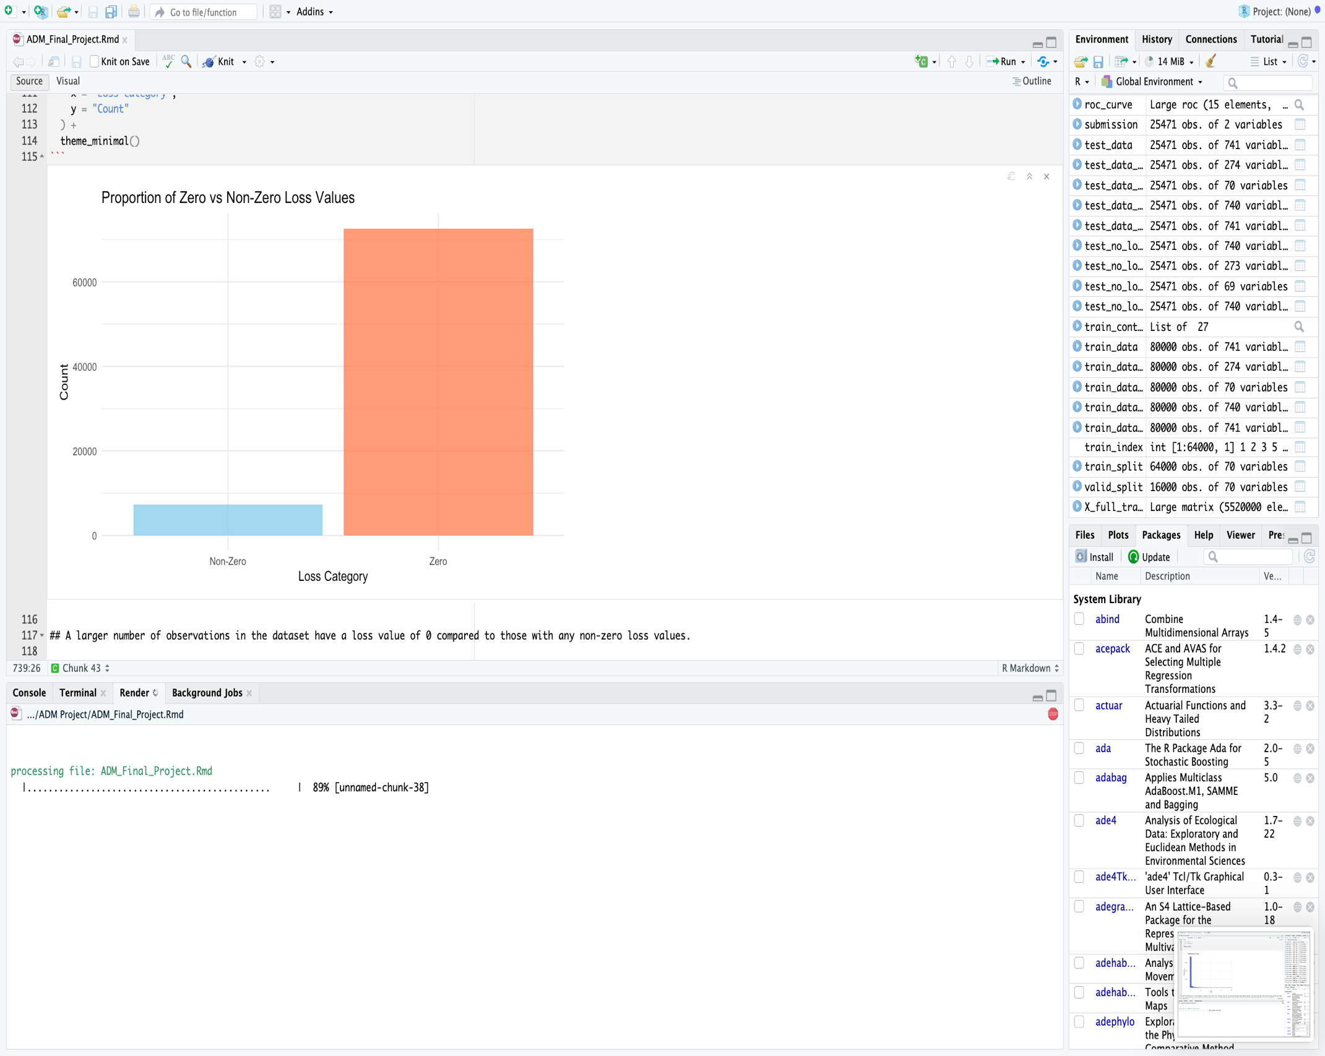
The histogram of the "loss" variable reveals that the distribution is right-skewed, indicating a decrease in frequency as loss values increase. Most data points are concentrated at lower loss values, with the mode appearing between 10 and 15. The "loss" values range from 0 to 80, showing a fairly dispersed distribution.
A bar plot was also used to compare the frequency of records with zero loss to those with non-zero loss. This visualization highlights that a significant proportion of the dataset has a loss value of 0, with sky blue bars representing non-zero loss and coral bars representing zero loss. This indicates that most loans in the dataset incurred no financial loss. These visualizations provide valuable context for understanding the distribution and prevalence of loss values in the dataset.

Slide 6
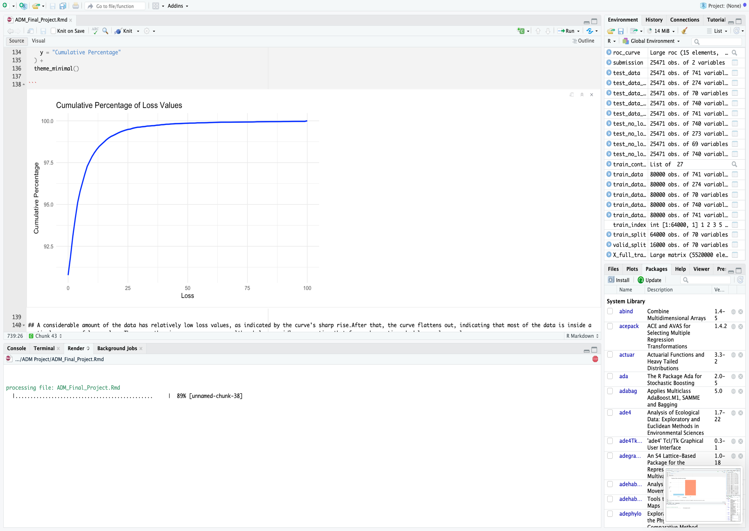
Cumulative Percentage of Loss data:
A line plot was used to illustrate the cumulative percentage of "loss" values in the dataset. This visualization provided insights into how loss values accumulate across the sample, making it easier to identify notable thresholds and observe trends in higher loss levels. By showing how the cumulative percentage changes with increasing loss values, the plot helped highlight critical points where the majority of the data is concentrated and the behavior of extreme loss values. This analysis is valuable for understanding the distribution and evaluating potential risk thresholds for decision-making.
The cumulative distribution line plot highlights that a substantial portion of the dataset has relatively low loss values, as evidenced by the sharp rise in the curve at the beginning. Following this, the curve flattens, indicating that the majority of the data falls within a specific range of lower loss values. Toward the higher loss levels, the curve begins to rise again, albeit more gradually, showing that fewer observations correspond to larger loss values.
These visualizations provided a foundational understanding of the "loss" distribution, uncovering key trends in the data. This analysis is crucial for identifying critical thresholds and will play a significant role in guiding further data exploration, feature engineering, and model development efforts.

Slide 7

Data Handling and Cleaning:
During preprocessing, the datasets were thoroughly analyzed and cleaned to address missing values. An initial summary revealed significant missing values across all three datasets: 593,281 in the training data and 191,194 in both the test and test-no-loss datasets. The percentage of missing data was calculated per column, with the maximum missing percentage reaching 17.83% in the training dataset and 17.95% in the test dataset, while some columns had no missing data. To enhance data quality, columns with over 50% missing values were eliminated, reducing the impact of incomplete data on subsequent analyses.
To better understand the extent of missing values, bar charts were created to visualize the columns with the highest and lowest percentages of missing data in the training and test datasets. These visualizations provided a clear basis for deciding how to handle missing data, ensuring a more robust dataset for model training and analysis. These steps streamlined the dataset and improved its suitability for machine learning applications.

Slide 8
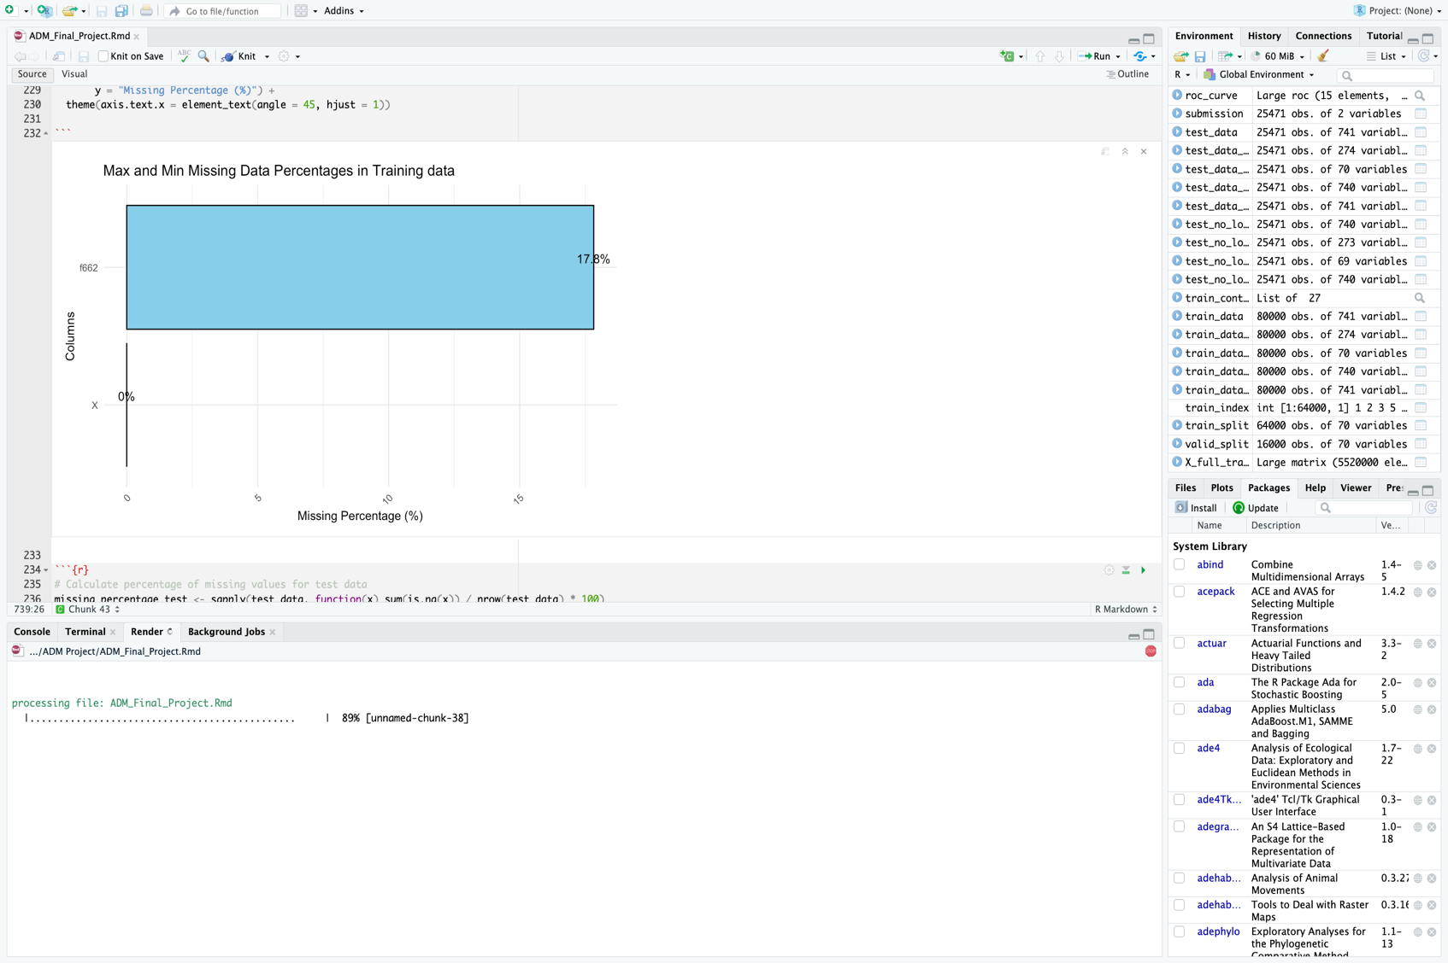
Maximum and Minimum Missing Data Percentages in Training data plot:

Slide 9
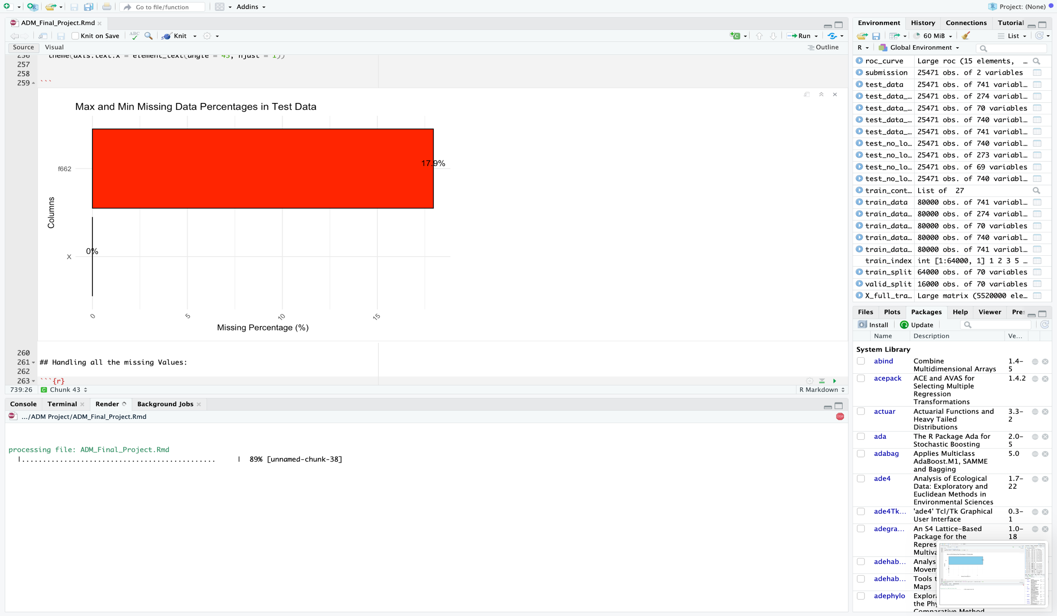
Maximum and Minimum Missing Data Percentages in Test data plot:

Slide 10

Imputation of Missing Values and Verification:
To address the remaining missing values after eliminating columns with excessive missing data, the median value of each column was used for imputation. This approach was selected to avoid potential misinterpretations that could result from using the mean, especially for skewed variables. The imputation process was applied consistently across the training, test, and test-no-loss datasets, ensuring that all datasets were complete.
After performing the imputation, a final check was conducted to verify that no missing values remained in any of the datasets. This step ensured data integrity, confirming that the datasets were now fully prepared for modeling and further analysis without concerns over incomplete data.

Slide 11
Data Preprocessing: Near-Zero Variance Feature Removal
The data preprocessing process began with the removal of near-zero variance (NZV) features. NZV features, due to their minimal variability, offer little predictive value for machine learning models. To identify and eliminate these features, the nearZeroVar() function from the caret package was used. This step helped streamline the dataset by removing features that contributed little to model performance, leaving the training dataset with 741 features, including the target variable. To maintain consistency across the datasets, the test datasets were also processed to ensure they contained only the same features as the training dataset. This step ensured a more efficient and relevant set of features for the subsequent modeling process.

Slide 12
Data Preprocessing: Data Scaling and Standardization
To prepare the data for machine learning models sensitive to feature scales, such as neural networks and support vector machines, the predictor variables were standardized. Using the preProcess function from the caret package, all numeric predictor variables were scaled and centered to have a mean of 0 and a standard deviation of 1. This step ensures that no feature dominates the model due to its original scale, thus improving model performance. The same scaling transformation was applied to both the training and test datasets to maintain consistency. However, the target variable (loss) was not scaled to preserve its original distribution, which is crucial for regression modeling.
After scaling, the datasets now have 741 features each (excluding the target variable in the test dataset). This preprocessing step ensures that the features are ready for input into machine learning models, which will result in better convergence rates and improved accuracy, particularly for algorithms that rely on normalized inputs. Boxplots were created for the first ten features in both the training and test datasets to visually verify the success of the scaling process. These boxplots highlight the distribution, variability, and potential outliers, confirming that the standardization was applied correctly and consistently across both datasets.

Slide 13
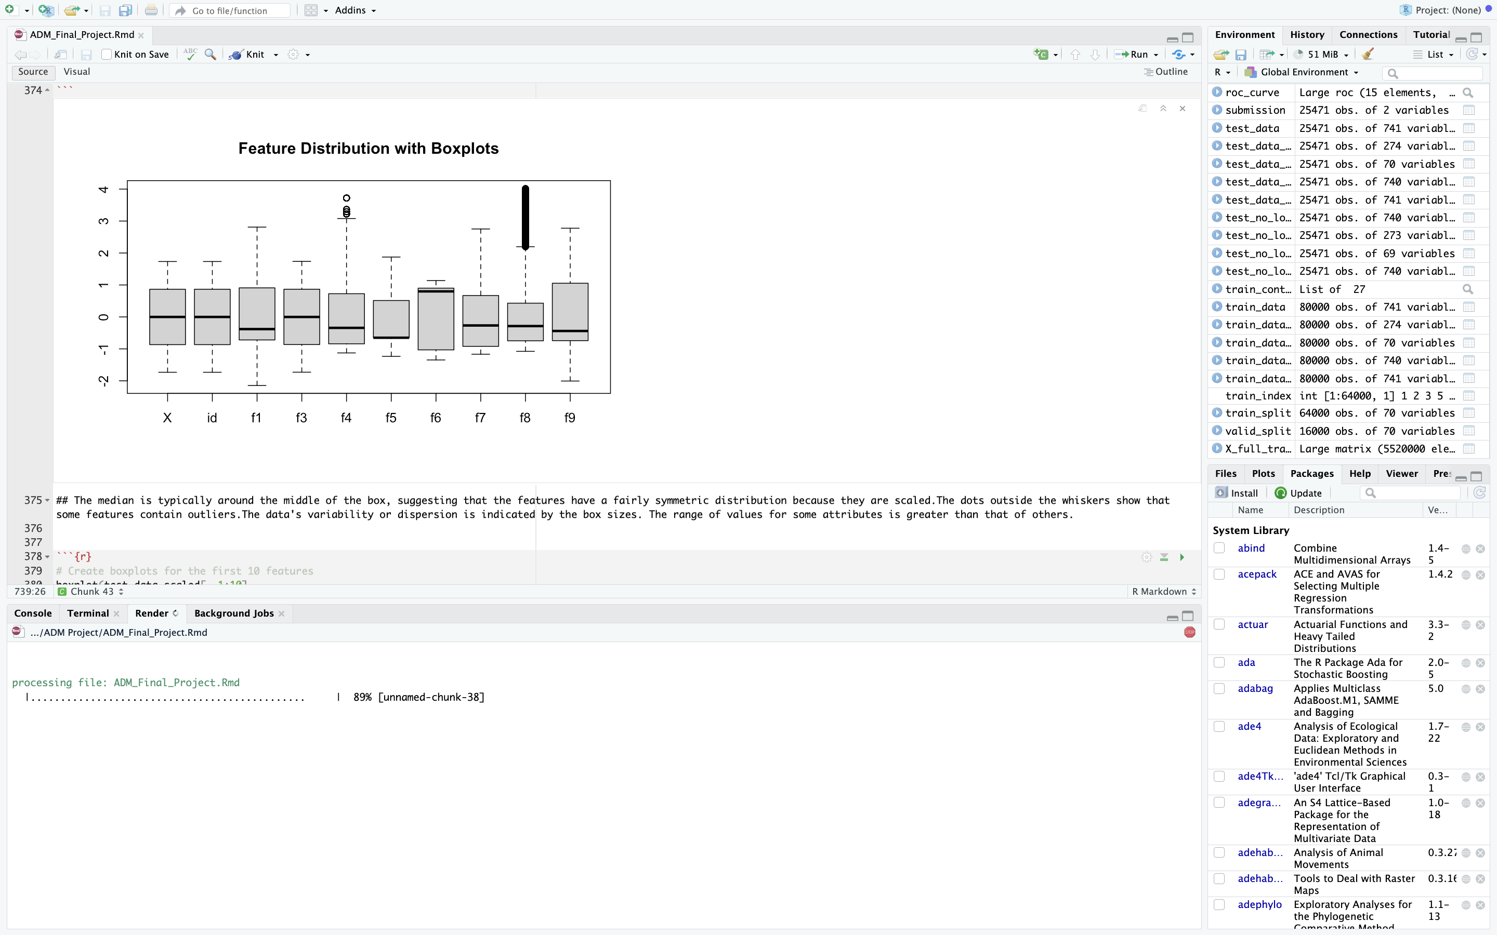
For Train Data:

Slide 14
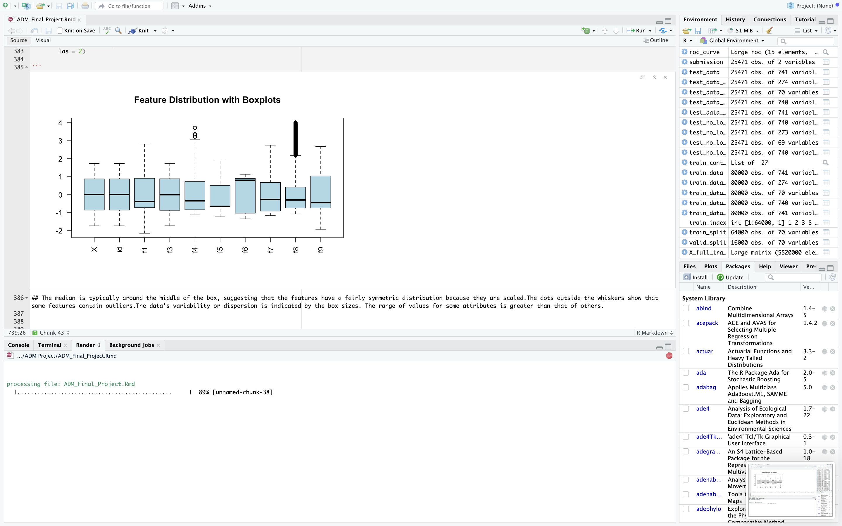
For Test data:

Slide 15
Feature selection is a crucial step in machine learning that reduces dimensionality, enhances model performance, and prevents overfitting. It helps by focusing on the most relevant features and improving computational efficiency.
For Correlation-Based Feature Selection, we identified and removed highly correlated features (above 0.9) to avoid multicollinearity. The target variable "loss" was excluded during this process. After filtering, the training and test datasets were aligned, ensuring consistency across all datasets. The test_no_loss dataset had 273 features, while the training and test datasets retained 274 features, all ensuring compatibility for model predictions.

Slide 16
Feature Selection and Data Splitting:
Lasso Regression for Feature Selection:
Lasso regression was used to select features based on their predictive importance. By applying L1 regularization, less significant features had their coefficients shrunk to zero. The optimal regularization parameter (lambda) was found using cross-validation, with a value of approximately 0.0142. This resulted in 69 significant features, which were retained for future modeling, simplifying the dataset while preserving essential predictors for loss prediction.
Splitting the Training Dataset: The training dataset was split into an 80-20 ratio, with 80% used for training the model and 20% for validation. This ensures that the model is evaluated on unseen data, improving its ability to generalize and preventing overfitting. The process was made reproducible by setting a random seed.

Slide 17
Modeling Strategy: Lasso Regression Model
In this project, Lasso Regression was chosen as one of the key modeling techniques to predict loan defaults and associated losses due to its ability to handle high-dimensional datasets and prevent overfitting. Lasso (Least Absolute Shrinkage and Selection Operator) is a regularization method that applies an L1 penalty to the regression coefficients, which helps shrink some coefficients to zero, effectively performing feature selection. This is particularly useful when there are many predictors, as it reduces the complexity of the model by retaining only the most significant features.
Cross-validation was employed to train the model and find the optimal lambda value, which controls the degree of regularization. The best lambda value, determined to be 0.004956714, was used to minimize overfitting and enhance prediction accuracy. The model's performance was evaluated using Mean Absolute Error (MAE), which yielded a value of 1.442777. Lasso regression was selected because of its ability to simplify the model, improve interpretability, and enhance generalization on unseen data, making it a suitable choice for this problem.

Slide 18
Modeling Strategy: Ridge Regression Model
Ridge Regression was used as an alternative to Lasso, offering a different approach to regularization. Unlike Lasso, which can shrink some coefficients to zero, Ridge applies an L2 penalty that shrinks all coefficients toward zero but does not eliminate any predictors. This helps address multicollinearity and prevents overfitting by reducing the impact of less significant features while keeping all variables in the model.
Ridge regression is particularly useful when all predictors are believed to have some level of predictive value, and when correlations between features are present. Cross-validation was used to determine the optimal lambda, which was found to be 1.11874. The model's performance was evaluated using the Mean Absolute Error (MAE), which was 1.444355. By stabilizing the solution and managing multicollinearity, Ridge regression is a valuable method to complement Lasso, offering a robust approach to handling feature interactions and preserving all features in the dataset.

Slide 19
Modeling Strategy: Random Forest Regression Model
The Random Forest regression model was chosen for its ability to handle complex datasets and capture non-linear relationships between features. As an ensemble learning method, Random Forest builds multiple decision trees and aggregates their predictions, improving accuracy and reducing the risk of overfitting. It is particularly useful for high-dimensional datasets, as it selects random subsets of features for each tree split, increasing flexibility and robustness while minimizing overfitting.
The model was tuned by adjusting the 'mtry' parameter, which controls the number of features considered at each split, using cross-validation. With 200 trees and an 'mtry' of 5, the model was trained and evaluated using Mean Absolute Error (MAE), yielding a result of 1.597924. Random Forest's ability to handle both categorical and continuous variables, manage missing data, and provide feature importance metrics made it a powerful choice for predicting loan defaults and losses, while offering insights into the most influential features.

Slide 20
Modeling Strategy: Neural Network
The Neural Network model was employed for its ability to capture complex, non-linear relationships in data, which traditional methods like linear regression might miss. Neural networks are particularly effective for large datasets with intricate patterns, as they can learn complex mappings between inputs and outputs. Their flexibility and adaptability make them suitable for challenging prediction tasks, such as estimating loan defaults and their severity.
For this project, the Neural Network was trained using cross-validation, with key parameters like decay rate and network size optimized. The model, with a decay rate of 0.1 and three layers, was evaluated on the validation set using Mean Absolute Error (MAE), resulting in an MAE of 1.449678. While the model performed well, it did not outperform the other techniques, highlighting that neural networks, although powerful, can be computationally expensive and require careful tuning to avoid overfitting. However, they remain a valuable tool for capturing complex data patterns.

Slide 21
The MAE values for each model are as follows:
Lasso MAE = 1.4557,
Ridge MAE = 1.4566,
Random Forest MAE = 1.6014, and
Neural Network MAE = 1.4604.
The results indicate that Lasso regression offers the best predictive performance, with the lowest Mean Absolute Error (MAE) of 1.4557 among the four models tested. Lasso regression excels due to its dual ability to both regularize and perform feature selection. By applying an L1 penalty, Lasso forces less important features to have zero coefficients, simplifying the model and reducing overfitting. This leads to improved generalization to unseen data, which is reflected in its lower MAE compared to Ridge regression, Random Forest, and Neural Network models. These other models may face overfitting challenges or require more extensive parameter tuning.
To visualize these results, a bar plot was created using ggplot2. In this plot, the model with the lowest MAE, Lasso regression, is colored green, while the other models are displayed in grey. The MAE values for each model are also displayed on top of the respective bars for easy comparison. The clear visual representation highlights Lasso as the superior model in terms of prediction accuracy, reinforcing its effectiveness in this task.

Slide 22
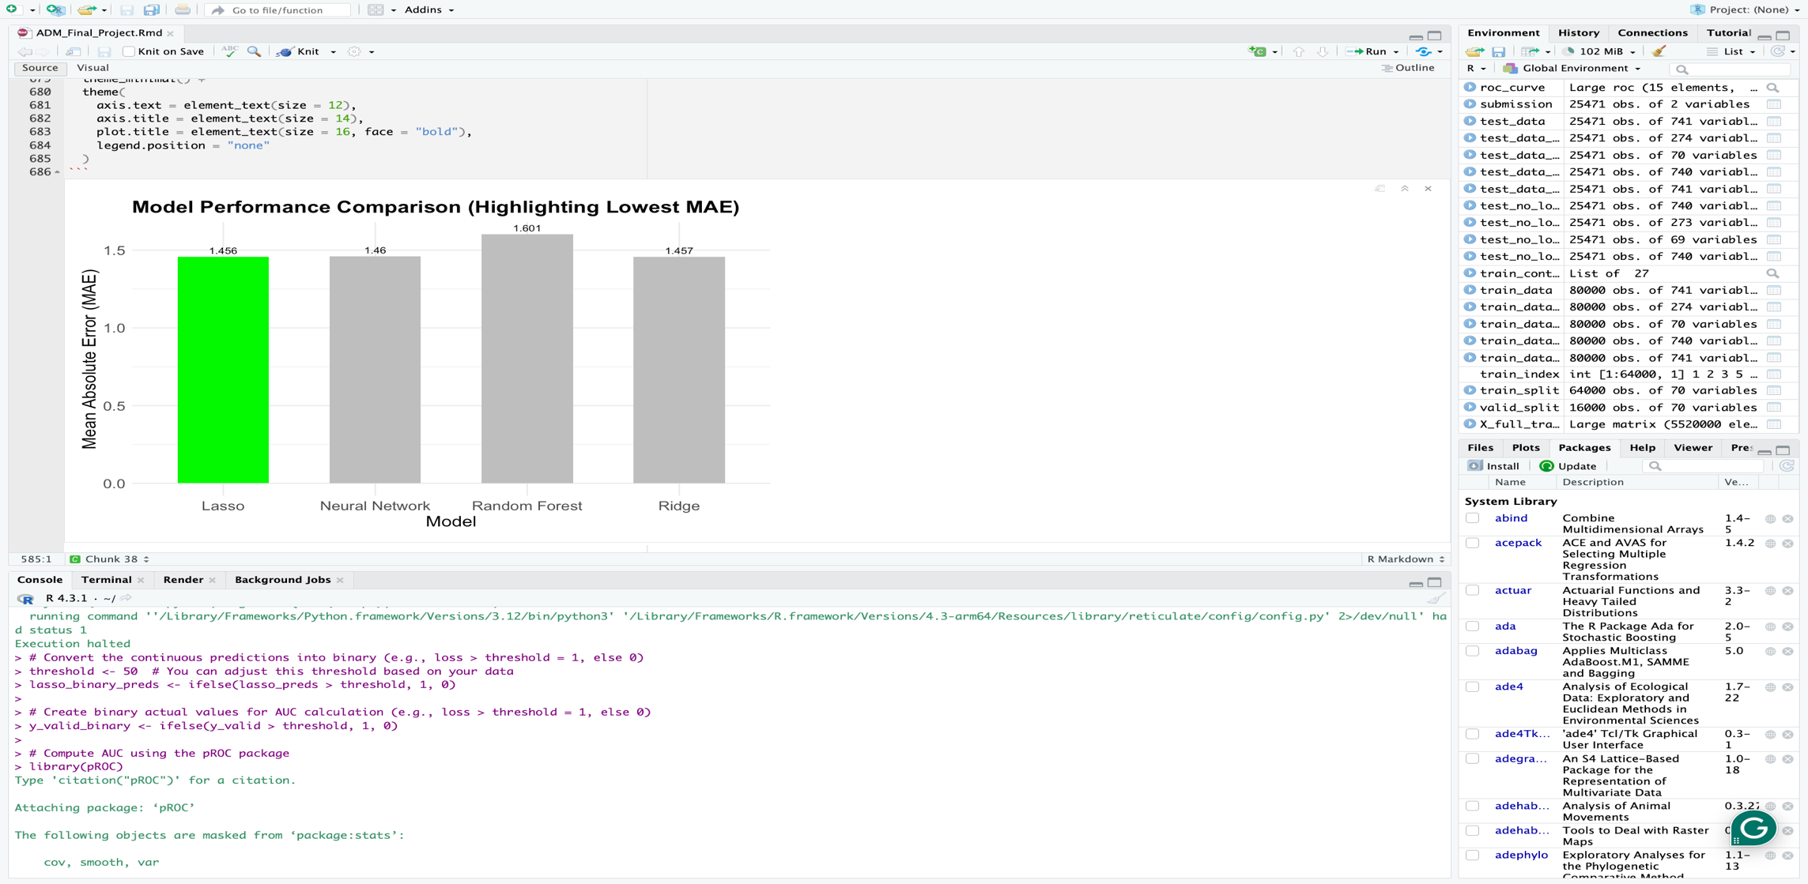

Slide 23
Saving Predictions to a New File:
In the final stage of the modeling process, the full training dataset, which includes both the training and validation splits, is used to train the Lasso regression model on all predictor variables. The dataset is scaled using the column means and standard deviations calculated from the training data to maintain consistency across both the training and test datasets, ensuring better generalization for the model. The Lasso model is then trained using cross-validation to determine the optimal regularization parameter, which is found to be 0.0024309.
After generating the predictions from the trained Lasso regression model, these predictions are saved to a new CSV file for submission. A new data frame is created, containing the "id" column from the test dataset (test_no_loss$id) and the predicted "loss" values (lasso_final_preds). The write.csv() function is then used to export this data frame to a file named "final_predictions.csv," ensuring that the row names are not included in the output. This step ensures that the predicted values are saved in a format that is easy to review, submit, or further analyze.

Slide 24

Thank You.

